Slide 1
LEADERSHIP AND MANAGEMENT

Slide 2

Self Assessment
After going through self-assessment process I found out that I possessed the followed strengths;
Includer; I accept other people to contribute towards an assignment.
Humility; I let the results of my work speak for themselves.
Notes:
There are different personal strengths that lead to effective leadership. some of the personal strengths that are associated with effective leadership are includer and humility.

Slide 3
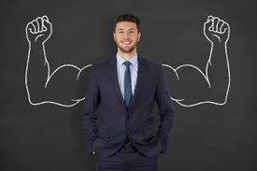
Cont…,
iii. Creativity; creativity refers to the ability of coming up with new ideas that assists in solving problems.
Creativity helps in solving the impossible in the business.
iv. Mental activity; is the ability of the brain of a person to think concerning a certain idea.
Effective leaders have a higher mental activity which enables them to come up with solutions.
Notes:
Creativity helps leaders to come up with new ideas that are used to solve business problems. Another leadership strength is that of having a higher mental activity. Mental activity enables leaders to think over a business problem and thus come up with solutions. It is from the different solution options that the leaders choose the best.

Slide 4
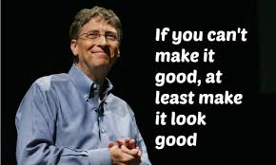
Compare and Contrast
Bill Gates and I share very little in terms of leadership attributes.
One of the common leadership attribute between Bill gate and I is that of creativity.
The other leadership trait that is common between Bill Gates and I is that of being an includer.
An includer likes to involve his or her juniors in the process of solving business problems.
Notes:
Bill Gates and I have only two of my major leadership attributes. One of the leadership trait that is common between two of us is that of including other people in the problem solving process. Also, we share a leadership trait of creativity. We are creative in such a way that we normally come up with new ideas of solving the problems that might arise in a business set up.

Slide 5
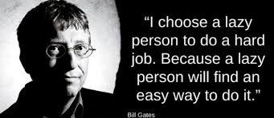
Cont…,
Bill gates likes taking on a practical approach in coming with goals while I do like being creative in such a way that, I just like coming up with new ideas to solve business issues.
He does not create a vision that cannot be meet (Gates& Lowe, 1998 ).
Instead he creates a vision that is achievable.
Notes:
Bill Gates and I do differ on the way we come up with goals. He likes coming up with goals that have to follow a certain a systematic way, while as for me I might at times jump to the next step whenever I get a good chance.

Slide 6
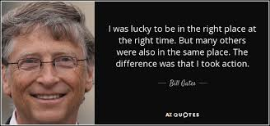
Cont…,
Bill gates believes that through reading he gets to learn new things. however, I like involving other people so that I can learn from them.
It is through reading that Gates gets the chance to explore of new things and hence advance his knowledge (Clifton, 2014).
Bill gates reads many books within a year.
Notes:
I believe that whenever I involve different people in a solution seeking process there will always be a solution. The different people come with their different expertise that in solving business issues. Through the diverse expertise I get the chance to learn more and to advance my leadership skills.

Slide 7
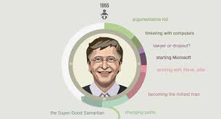
Career Track and Growth
Bill Gates became a great manager in the past five decades.
He is know for planning, directing, controlling, staffing for the company and organizational skills (Demuth, 2013).
Through the above listed expertise, bill Gates was able to propel the organization to great heights of success.
Bill Gates has been able to apply his planning skills to help the company meet the changing market demand (Thornberry, 2001).
Notes:
Bill Gates has been performing well for the last five decades in terms of leadership. he has helped the company to excel and overcome much of the market challenges. He has been applying his planning skills to help the organization navigate through the ever changing-market. technology is dynamic in nature and thus for one to be competitive in the market has to be innovative.

Slide 8
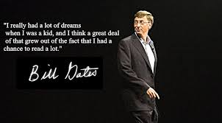
Cont…,
Through his staffing skills, Bill Gates has been able to have an excellent team that is made up of qualified workers who have led the organization to excellence.
Bill gates strives to learn on daily basis, specifically on communication and public speaking skills (Benko & Weisberg, 2007).
Gates seeks advice from other individuals and is also known for his vision that allows the organization to be innovative and thus competitive within the market.
Notes:
Bill Gates ensures he has the set of employees who will help advance the organization towards realization of its goals. Also, Gates seeks advice from other people which enables him in solving problems that might be facing him in his job.

Slide 9
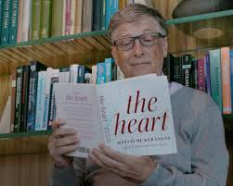
Cont…,
Bill Gates is caring and gives back to the society.
Whatever his company makes, Gates ensures that a certain percentage goes back to the society and also to the employees.
He is concerned about other people and tirelessly works to ensure that they grow.
Notes:
Bill Gates is concerned about the community and thus he channels back some of the organization’s proceeds to the society. He is caring and likes making other people successful.

Slide 10
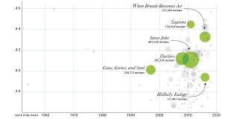
Leadership Skills to Improve Organizational Structure, Operations, and Communications
Bill Gates gives his employees an opportunity to grow.
A great leader creates a positive organizational culture which gives the workers a chance to explore on their full potential.
He creates an effective organizational structure that enables the communication protocols that enable the employees to be involved in all stages.
It is through involving all employees in the production process that they get the chance to contribute towards the success of the process.
Notes:
Workers should be given an opportunity to get involved in the communication process so that they can get a chance to contribute in the problem solving process. Also, through the involving of the employees in the decision making process gives them a chance to improve.

Slide 11
Cont…,
It is through the different transparent communication channels that the workers are given a chance to contribute in the organization's activities.
The workers are given a chance to contribute their views concerning improvement of policies, procedures and processes.
Bill Gates is said to be a strategist who takes on the role of ensuring that the operational side of the organization is effective
He also motivates the workers towards ensuring realization of the company’s goals.
Notes:
Through the proper and effective communication channels, the organization realizes its goals. Employees are given a better chance of exploiting on the potential.

Slide 12
References
Benko, C., & Weisberg, A. C. (2007). Mass career customization: Aligning the workplace with today's nontraditional workforce.
Clifton, J. (2014). Entrepreneurial strengthsfinder: Finding and engaging the world's most talented business. Place of publication not identified: Gallup Press.
Demuth, P. B., Hammond, T., Harrison, N., & OverDrive, Inc. (2013). Who Is Bill Gates?. Place of publication not identified: Penguin Young Readers Group.
Gates, B., & Lowe, J. (1998). Bill Gates speaks: Insight from the world's greatest entrepreneur. New York: John Wiley.
Thornberry, N. (2001). Corporate entrepreneurship:: antidote or oxymoron?. European Management Journal, 19(5), 526-533.

